Slide 1
Vehicle Servicing Center
By: Momin Mubashshir (1118)
Nikhil Dhane (1049)

Slide 2
Introduction
Customers land such as online vehicle service center seeking for immediate solution in time of emergency shouldn't have to wait for booking completion , we have decided a reasonable price for service.

Slide 3
Problem Statement
It doesn’t matter how much people hate complying with the need for maintenance of vehicles.
. They need to complete the same responsibilities to avoid the issues that may arise on the road.
This is true that people don’t like to get involved in such messy jobs, but they don’t have a choice in the matter as all the vehicles require routine servicing and immediate repairs when trouble arises.

Slide 4
Objectives
To produce a web-based system that allow the admin to Vehicle servicing facilities and provide functionalities to its role.
To ease owner by providing different functionalities to it.
To ease customer to solve vehicle problem effectively.

Slide 5
Benefits of vehicle Servicing:-
This online Vehicle servicing solution is fully functional and flexible.
It is very easy to use.
It saves a lot of time of customer.
Eco-friendly: The monitoring of the Vehicle servicing and the overall business becomes easy and includes the least of paper work.
The application acts as an office that is open 24/7.
It increases the efficiency of the management at offering quality services to the customers.
It provides custom features development and support with the application.

Slide 6
Users and Characteristics:
Admin
Admin can login to the system.
View the list of all the customer details.
Delete customer.
Update customer schedule status pending/done.
View Complaints of customer.
View workers detail
Customer:
View his/her details.
View Schedule details.
Update their personal credentials.
View total bill.

Slide 7
Implementation Constraints:
The application will use Ajax, JavaScript, jQuery and css as main web technologies.
Several types of validations make this web application a secured one and SQL Injections can also be prevented.
Since system is a web-based application, internet connection must be established.
The vehicle service System will be used on PCs and Android mobile and will function via internet or intranet in any web browser.

Slide 8
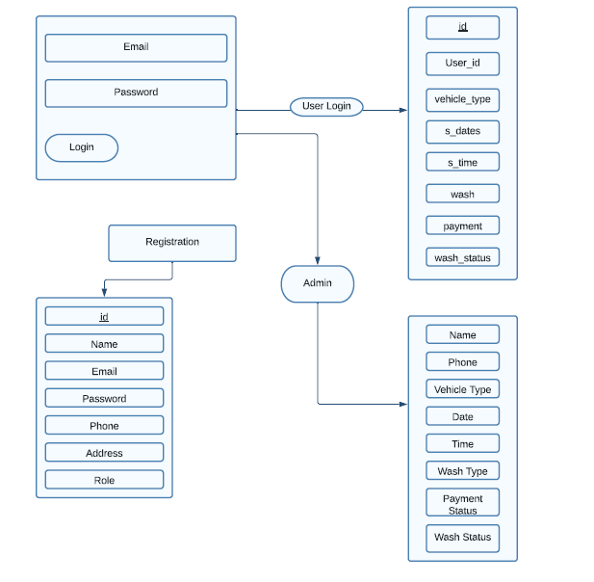
Activity Diagram

Slide 9
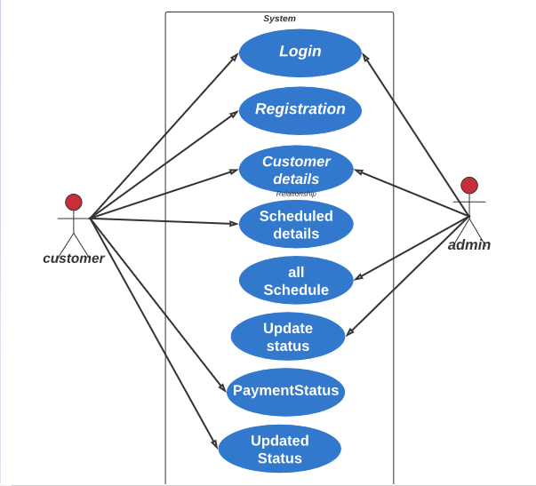
Use Case Diagram

Slide 10
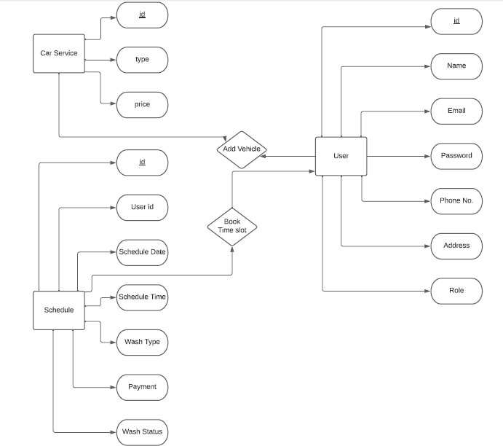
ER Diagram

Slide 11
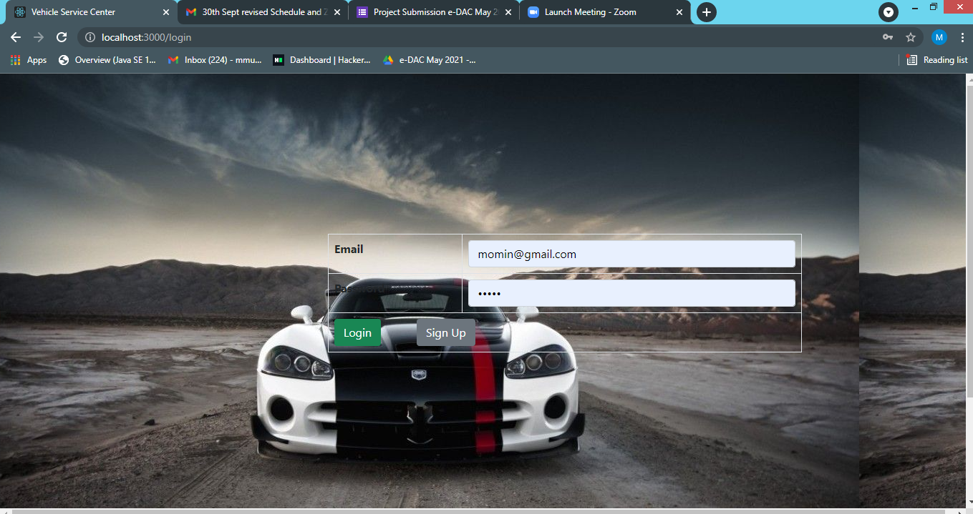
Screenshots: Login Page

Slide 12
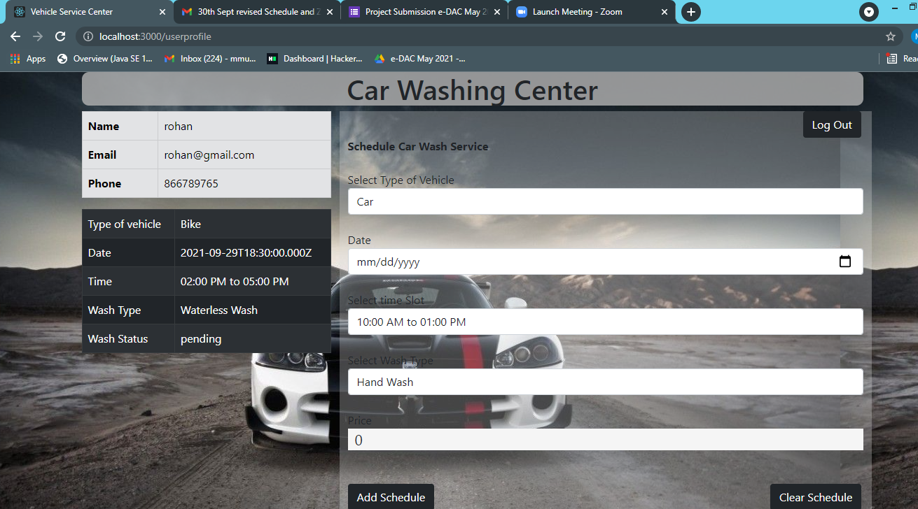
User Login

Slide 13
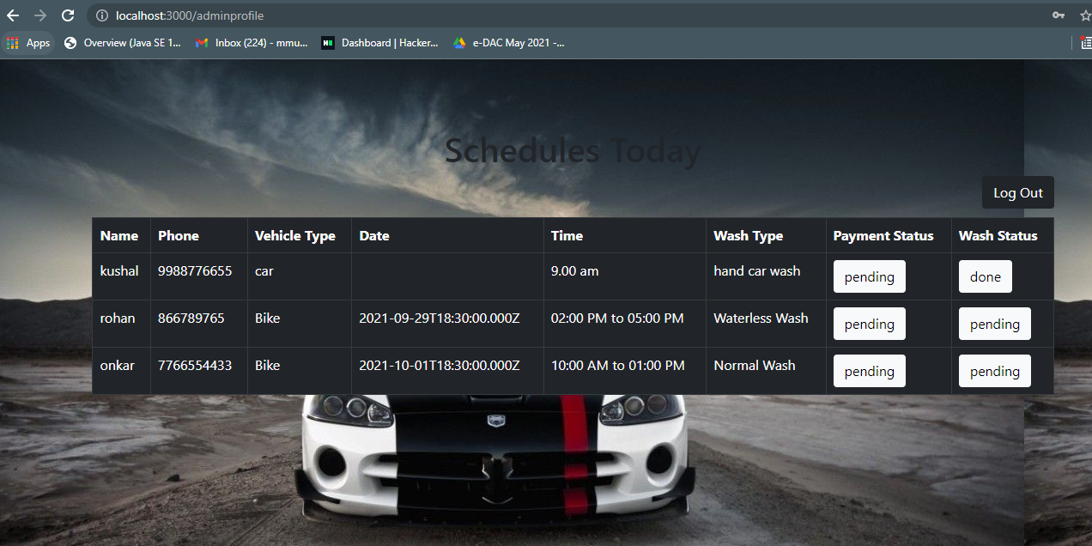
Admin Login

Slide 14
Conclusion
Producing new customer service skills have changed past that used to cost you hours in comparing, searching, and waiting at the service centers and repair shops to get your vehicle serviced or repaired.
From our service we solved all most of problem faced by customer regarding their vehicle.
This technology benefits the customers or vehicle owners and leverages more significant revenues for companies across the automotive industry and auto service businesses.

Slide 15
References
•https://getbootstrap.com/
• https://reactjs.org/docs/

Slide 16
Thank You

